Slide 1

SnapPong Final Presentation
CS 262 Team D

Slide 2
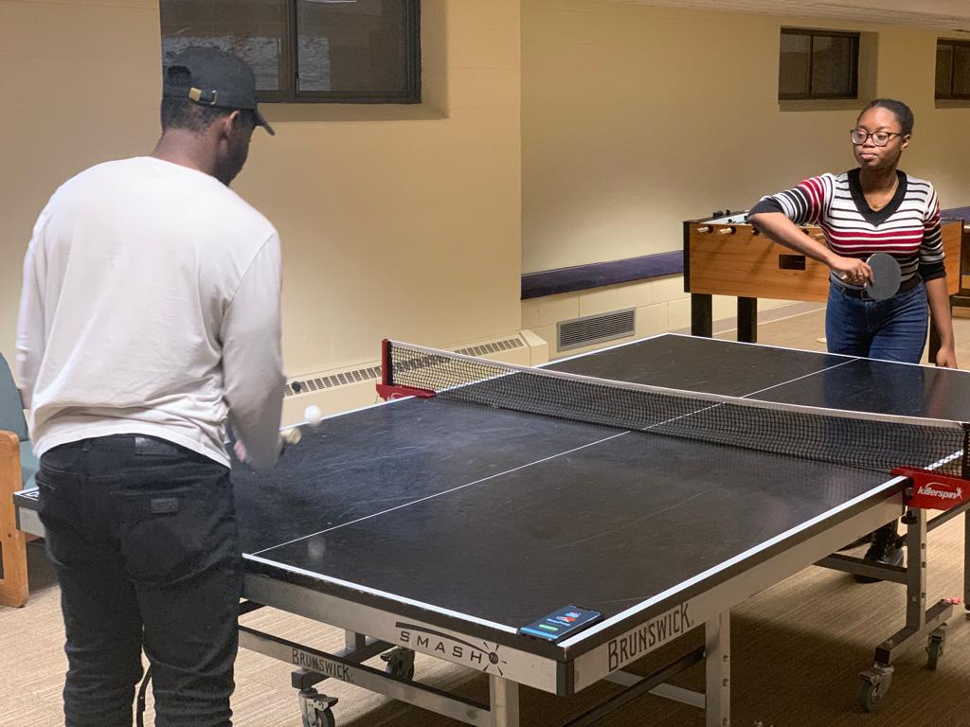
I miss the old way of keep track of scores.
This time he wouldn’t say it was 5-5 when it was 5 - 0

Slide 3
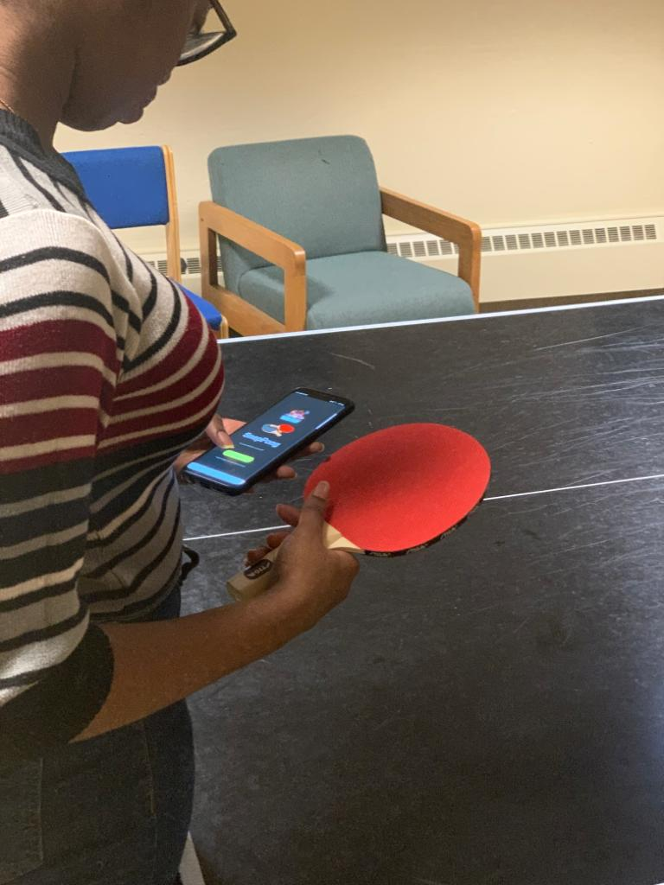
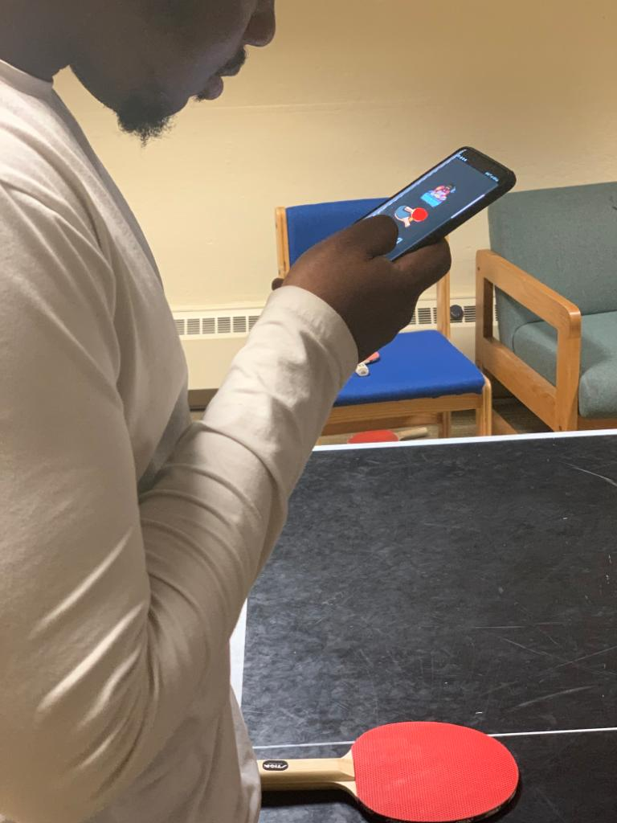
GAME OVER

Slide 4
DEMO

Slide 5
Project Vision
SnapPong …
is created for students of Calvin University
who want a unique ping-pong leaderboard and scorekeeping application
to combine social media and ping pong
unlike other applications that only act to record game scores
it implements game requests and login via Snapchat,
displays a live leaderboard of users ordered by skill-based ELO ratings,
and implements familiar Bitmoji icons for avatars

Slide 6
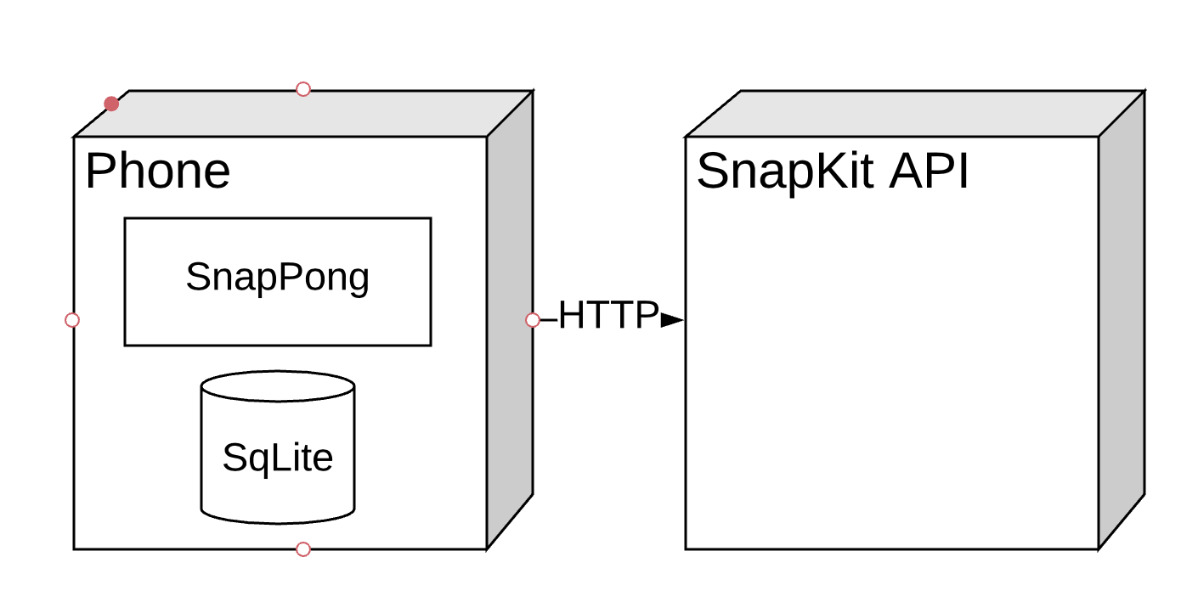
Deployment Diagram

Slide 7
Future Work/Challenges
Game requests through Snapchat
Create a privacy policy page for official product status
Move database to cloud service such as Firebase

Slide 8
Current State
Currently we can:
Login
See a leaderboard
Interact with scores shown on leaderboard
View a profile page

Slide 9
Postman’s 4th Idea

Slide 10
Questions?

